Slide 1
All about Baptism for Adults

Slide 2
Baptism is one way to show people that you love Jesus and want to follow Him.

Slide 3
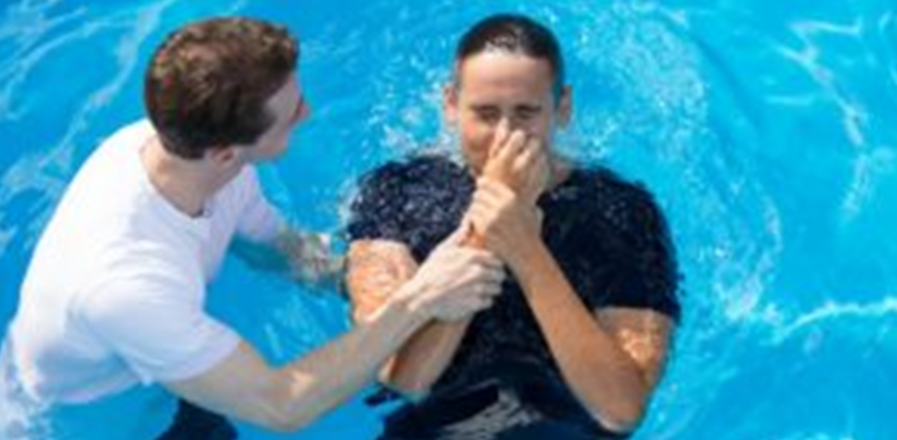
At a service of baptism, a person goes into a big pool of water. There is someone to help them to go under the water. They come up again quickly. There may be special songs and prayers.

Slide 4
Have you ever seen a baptism?

Slide 5
Baptism is for people who follow and love Jesus. They want to be close to God forever.

Slide 6
We all do wrong things. Everyone turns away from God. This is sin.

Slide 7
If we tell God that we are sorry for our sin, then God forgives us. It is good.

Slide 8
Jesus says God is like a good father.
He loves us and wants us to be close to him.

Slide 9
You can read this story in Luke 15: “While the son was still a long way off, his father saw him. He was filled with tender love for his son. He ran to him. He threw his arms around him and kissed him.” Luke 15:20 New International Reader’s Version

Slide 10
Jesus loves us. He died on the cross to bring us close to Father God.

Slide 11
What do you think about Jesus?

Slide 12
Why do people get baptised?

Slide 13
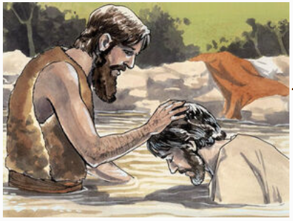
Before Jesus started to teach about God’s love, he went to his cousin John. John baptised Jesus in the river. We get baptised to be like Jesus.

Slide 14
Jesus said to his friends: “Go and make followers of all people in the world. Baptise them in the name of the Father and the Son and the Holy Spirit.” Matthew 28:18-20 Easy-to-read Version We get baptised because Jesus asks us to

Slide 15
We get baptised to show that we are part of God’s family.

Slide 16
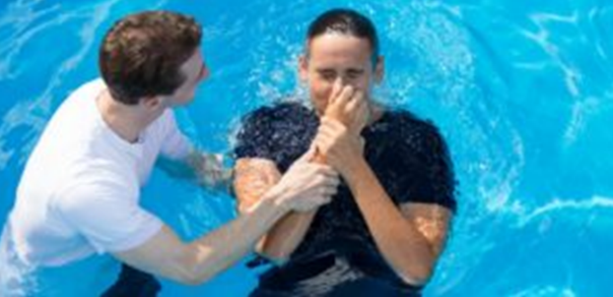
Why do people go under the water at baptism?

Slide 17
Baptism in water shows people that God has forgiven us. Jesus has made us clean on the inside.

Slide 18
The Bible says: “The water of baptism does not wash dirt from a person's body. Instead, it shows that a person has decided to obey God. He is choosing to do what is right.” 1 Peter 3:21 Easy English Bible

Slide 19
When we go down into the water, we remember Jesus’ death. When we come up out of the water, we remember Jesus rising from death. Baptism is a sign of new life. We can celebrate!

Slide 20
Sometimes people can’t go all the way into the water. This is OK. Your church leader can help you to find a way.

Slide 21
It may help to see someone else being baptised. You can watch a video too. Ask other Christians questions or get them to tell you about their baptism. .

Slide 22
What else you want to know about baptism?

Slide 23
It’s good to think and pray about baptism. It’s your decision.

Slide 24
“Do not worry about anything. Instead, pray to God about everything.
If you do that, God will give you peace…You will not worry or be afraid, because you belong to Christ Jesus.”
Philippians 4:6-7 Easy English Bible

